Slide 1
You will find a template for your presentation in the next few slides.
The design of the TITLE PAGE (slide no.2) including font style, line spacing, backgrounds, and colours is mandatory.
The proposed color scheme and font style are mandatory throughout the whole PowerPoint presentation. The story you will give during your presentation should contribute to the theme of the conference, which is: “Two decades of discovery: advancing science and solutions”.
Each presentation will have a five-minute limit and the minimum length of presentation required is three minutes. Afterwards there is a one minute timeframe for discussion. In the first break after your session, you will need to be available for a discussion regarding your presentation/work.
Title font: Century Gothic. Font of other texts: Franklin Gothic Book.
After reading the instructions above, please, delete this slide.
PRESENTATION SHOULD BE SAVED AS:
StudyProgramme_StudyYear_Faculty / PostgraduateSchool_Author Example:
NANO_1_MPS_NovakJanez-presentation.pptx

Slide 2
Title of your presentation (Font: Century Gothic)
Presenter’s first and last names
Supervisor(s):
Affiliation(s) – add also the department.
Advancing Science and Solutions

Slide 3
Introduction: aims, scopes, methods
This slide should be an introduction to what you do, but please, do not present the theoretical background of your work.
Name the problem of your research
Present the AIM, SCOPE, METHODS, etc.
Ask yourself three golden questions:
WHAT?
WHY?
HOW?
Use only material you own or you are allowed to use
If you need to cite something, use superscript, like this¹, then put the reference at the bottom of the slide
GENERAL PROBLEM
NARROW IT
DOWN
SPECIFICS
¹ F. Last, et al., Sci., XX, 2021. (delete this section if not used)

Slide 4
Results and conclusion
Here is the place to describe your work - what did you do and why.
How (and why) your science is contributing to expand your science research field?
Don’t be afraid to be specific, just mind explaining everything slowly (have in mind that your audience is broader than usual).
Feel free to present your research data and/or findings anyhow you like, be creative, but always keep in mind that the audience should be able to see and understand everything you put on the slide.
Do not make these slides too full and chaotic (like this one).
Lead the audience through your slides, do not let them get lost.
Make sure you are showing what you are talking about (synchronize your talk with the visual appearance of the slides).

Slide 5
The previous two slides must be included in your talk, but this one is completely optional (also, design the last slide according to your own wishes, if you do not like this background).
Here you can thank the audience, invite people to your poster (if you prepared one), list all relevant affiliations, fundings, etc.
You can also leave your contact here.
NOTE that all contributions that fulfil the requirements (abstract, presentation, and poster) participate in the competition for the best submission awards.

Slide 6
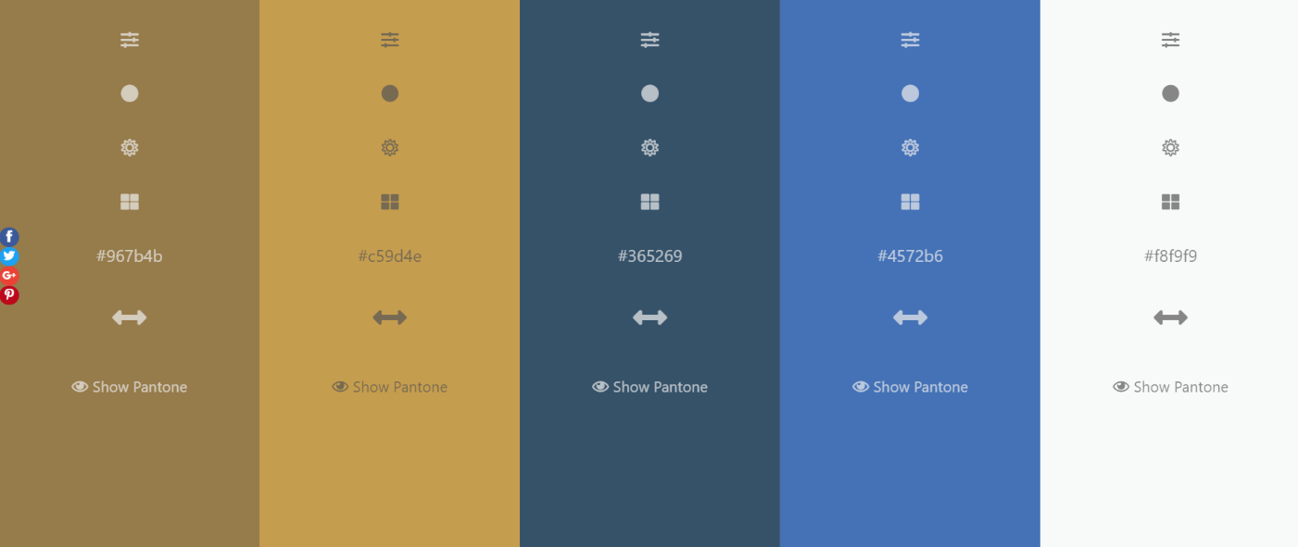
If you want to design by yourself, here is the colour palette that we used.
After reading the instructions above, please, delete this slide.

